Slide 1
Optimizing energy potentials for success in protein tertiary structure prediction
Ting-Lan Chiu and Richard A Goldstein
Folding and Design
Volume 3, Issue 3, June 1998, Pages 223-228
Speaker: Chun-Jen Chen
Date: Sept. 1, 2009

Slide 2
Abstract
Background: Success in solving the protein structure prediction problem relies on the choice of an accurate potential energy function. For a single protein sequence, it has been shown that the potential energy function can be optimized for predictive success by maximizing the energy gap between the correct structure and the ensemble of random structures relative to the distribution of the energies of these random structures (the Z-score). Different methods have been described for implementing this procedure for an ensemble of database proteins. Here, we demonstrate a new approach.
115/11/08

Slide 3
Abstract
Results: For a single protein sequence, the probability of success (i.e. the probability that the folded state is the lowest energy state) is derived. We then maximize the average probability of success for a set of proteins to obtain the optimal potential energy function. This results in maximum attention being focused on the proteins whose structures are difficult but not impossible to predict.
Conclusions: Using a lattice model of proteins, we show that the optimal interaction potentials obtained by our method are both more accurate and more likely to produce successful predictions than those obtained by other averaging procedures.
115/11/08

Slide 4
Introduction
Predicting the three-dimensional conformation of a correctly folded protein can be divided into two distinct steps:
The construction of a fitness function to evaluate the various conformations
Search through various possible conformations for the ‘best’ prediction most likely to represent the native state.
115/11/08

Slide 5
According to Goldstein, Luthey-Schulten and Wolynes (GLW; [10,11,15,16]), the important quantity was the difference in energy level of the correct native state compared with the average energy level of the random conformations (Δ), divided by the standard deviation of the energy levels of the random conformations (Γ);
Maximize (Δ/ Γ)
115/11/08

Slide 6


MS Approach
Mirny and Shakhnovich (MS; [12]) maximized the harmonic average of individual Z-scores to obtain the optimal potential for a set of proteins.

Slide 7
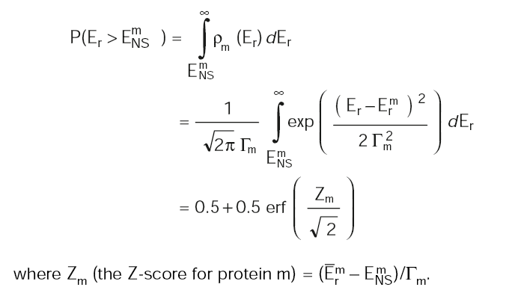
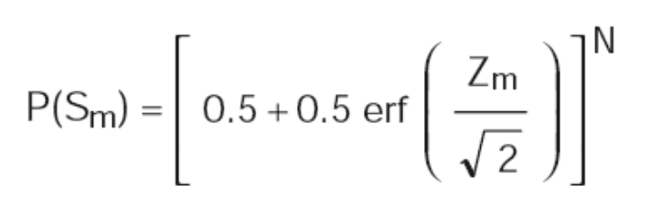
Methods
Maximize
115/11/08

Slide 8

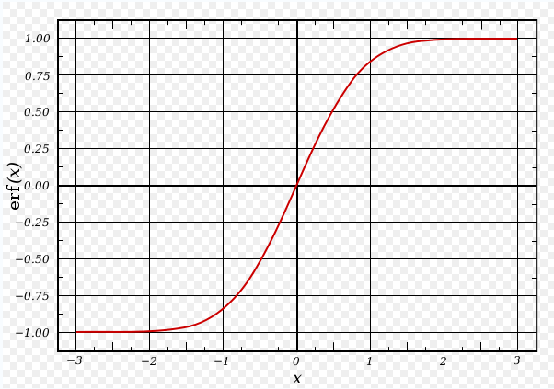
Error Function
115/11/08

Slide 9
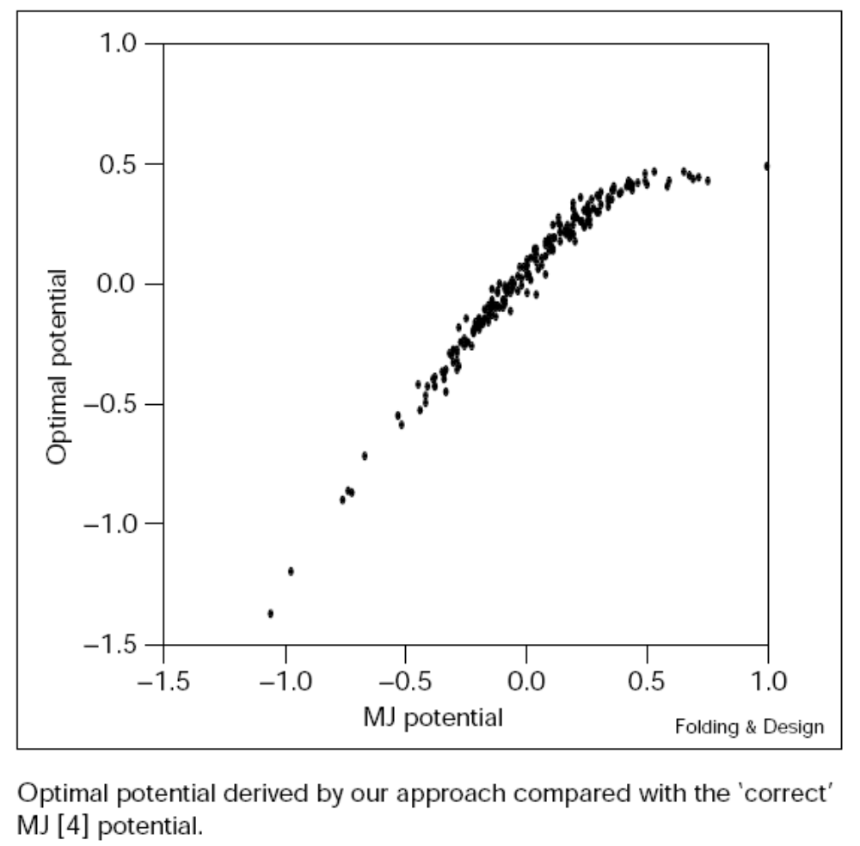
Results

Slide 10
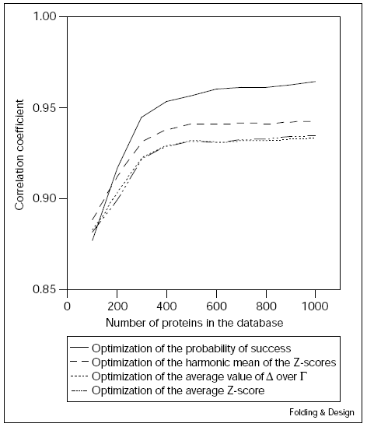

Slide 11
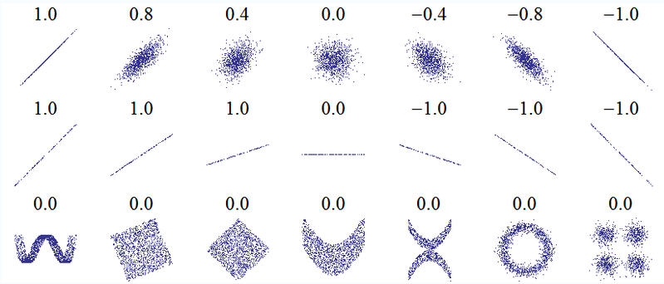
Correlation Coefficient

